Slide 1
Design and Analysis of Algorithms
Quick Sort
National University of Computer and Emerging Sciences, Islamabad

Slide 2
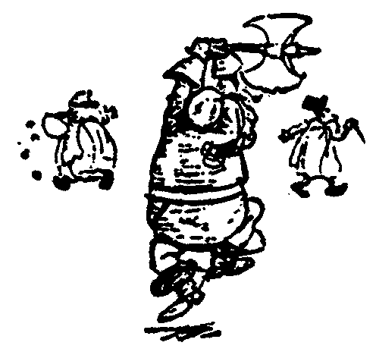
Quick Sort
88
52
14
31
98
25
30
62
23
79
Divide and Conquer

Slide 3
Quick Sort
Partition set into two using
randomly chosen pivot
88
52
14
31
98
25
30
62
23
79
14
88
98
31
30
≤ 52 ≤
62
25
23
79

Slide 4
Quick Sort
14
88
98
31
30
≤ 52 ≤
62
25
23
79
sort the first half.
sort the second half.
14,23,25,30,31
62,79,98,88

Slide 5
Quick Sort
14,23,25,30,31
52
62,79,88,98
Glue pieces together.
14,23,25,30,31,52,62,79,88,98

Slide 6
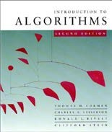
Quicksort
Proposed by C.A.R. Hoare in 1962.
Divide-and-conquer algorithm.
Sorts “in place” (like insertion sort, but not like merge sort).
Very practical (with tuning).

Slide 7




Divide and conquer
Quicksort an n-element array:
1. Divide: Partition the array into two subarrays around a pivot x such that elements in lower subarray ≤ x ≤ elements in upper subarray.
≤ x
x
≥ x
Conquer: Recursively sort the two subarrays.
Combine: Trivial.
Key: Linear-time partitioning subroutine.

Slide 8





Partitioning subroutine
PARTITION(A, p, q) ⊳ A[ p . . q]
x ← A[ p] ⊳ pivot = A[ p]
Running time
i ← p
= O(n) for n
elements.
for j ← p + 1 to q
do if A[ j] ≤ x
then i ← i + 1
exchange A[i] ↔ A[ j]
exchange A[ p] ↔ A[i]
return i
Invariant: x ≤ x
≥ x
?
p
i
j q

Slide 9





Example of partitioning
6 10 13 5 8 3 2 11
i j

Slide 10
Example of partitioning
6 10 13 5 8 3 2 11
i j

Slide 11
Example of partitioning
6 10 13 5 8 3 2 11
i j

Slide 12
Example of partitioning
6 | 10 | 13 | 5 | 8 | 3 | 2 | 11
6 | 5 | 13 | 10 | 8 | 3 | 2 | 11
 | i |  | j

Slide 13
Example of partitioning
6 | 10 | 13 | 5 | 8 | 3 | 2 | 11
6 | 5 | 13 | 10 | 8 | 3 | 2 | 11
 | i |  |  | j

Slide 14
Example of partitioning
6 | 10 | 13 | 5 | 8 | 3 | 2 | 11
6 | 5 | 13 | 10 | 8 | 3 | 2 | 11
 | i |  |  |  | j

Slide 15
Example of partitioning
6 | 10 | 13 | 5 | 8 | 3 | 2 | 11
6 | 5 | 13 | 10 | 8 | 3 | 2 | 11
6 | 5 | 3 | 10 | 8 | 13 | 2 | 11
 |  | i |  |  | j

Slide 16
Example of partitioning
6 | 10 | 13 | 5 | 8 | 3 | 2 | 11
6 | 5 | 13 | 10 | 8 | 3 | 2 | 11
6 | 5 | 3 | 10 | 8 | 13 | 2 | 11
 |  | i |  |  |  | j

Slide 17


Example of partitioning
6 | 10 | 13 | 5 | 8 | 3 | 2 | 11
6 | 5 | 13 | 10 | 8 | 3 | 2 | 11
6 | 5 | 3 | 10 | 8 | 13 | 2 | 11
6 | 5 | 3 | 2 | 8 | 13 | 10 | 11
 |  |  | i |  |  | j

Slide 18
Example of partitioning
6 | 10 | 13 | 5 | 8 | 3 | 2 | 11
6 | 5 | 13 | 10 | 8 | 3 | 2 | 11
6 | 5 | 3 | 10 | 8 | 13 | 2 | 11
6 | 5 | 3 | 2 | 8 | 13 | 10 | 11
 |  |  | i |  |  |  | j

Slide 19
Example of partitioning
6 | 10 | 13 | 5 | 8 | 3 | 2 | 11
6 | 5 | 13 | 10 | 8 | 3 | 2 | 11
6 | 5 | 3 | 10 | 8 | 13 | 2 | 11
6 | 5 | 3 | 2 | 8 | 13 | 10 | 11
 |  |  | i |  |  |  |  | j

Slide 20
Example of partitioning
6 | 10 | 13 | 5 | 8 | 3 | 2 | 11
6 | 5 | 13 | 10 | 8 | 3 | 2 | 11
6 | 5 | 3 | 10 | 8 | 13 | 2 | 11
6 | 5 | 3 | 2 | 8 | 13 | 10 | 11
2 | 5 | 3 | 6 | 8 | 13 | 10 | 11
 |  |  | i

Slide 21
Pseudocode for quicksort
QUICKSORT(A, p, r)
if p < r
then q ← PARTITION(A, p, r) QUICKSORT(A, p, q–1) QUICKSORT(A, q+1, r)
Initial call: QUICKSORT(A, 1, n)

Slide 22
Analysis of quicksort
Assume all input elements are distinct.
In practice, there are better partitioning algorithms for when duplicate input elements may exist.
Let T(n) = worst-case running time on an array of n elements.

Slide 23
Worst-case of quicksort
Input sorted or reverse sorted.
Partition around min or max element.
One side of partition always has no elements.
T (n) = T (0) + T (n −1) + Θ(n)
= Θ(1) + T (n −1) + Θ(n)
= T (n −1) + Θ(n)
= Θ(n² )
(arithmetic series)

Slide 24
Worst-case recursion tree
T(n) = T(0) + T(n–1) + cn

Slide 25
Worst-case recursion tree
T(n) = T(0) + T(n–1) + cn T(n)

Slide 26
Worst-case recursion tree
T(n) = T(0) + T(n–1) + cn
cn
T(0) T(n–1)

Slide 27
Worst-case recursion tree
T(n) = T(0) + T(n–1) + cn
cn
T(0) c(n–1)
T(0) T(n–2)

Slide 28
Worst-case recursion tree
T(n) = T(0) + T(n–1) + cn
cn
c(n–1) T(0) c(n–2)
T(0)
T(0)

Θ(1)

Slide 29
Worst-case recursion tree
T(n) = T(0) + T(n–1) + cn
cn
c(n–1)
T(0) c(n–2)
T(0)
⎛ n
⎞
Θ⎜ ∑k ⎟ = Θ(n² )
T(0)
⎝ k =1
⎠

Θ(1)

Slide 30
Worst-case recursion tree
T(n) = T(0) + T(n–1) + cn
cn
Θ(1) c(n–1)
⎛ n
⎞
Θ⎜ ∑k ⎟ = Θ(n² )
⎝ k =1
⎠
T(n) = Θ(n) + Θ(n²)
= Θ(n²)
Θ(1) c(n–2)
h = n
Θ(1)

Θ(1)

Slide 31
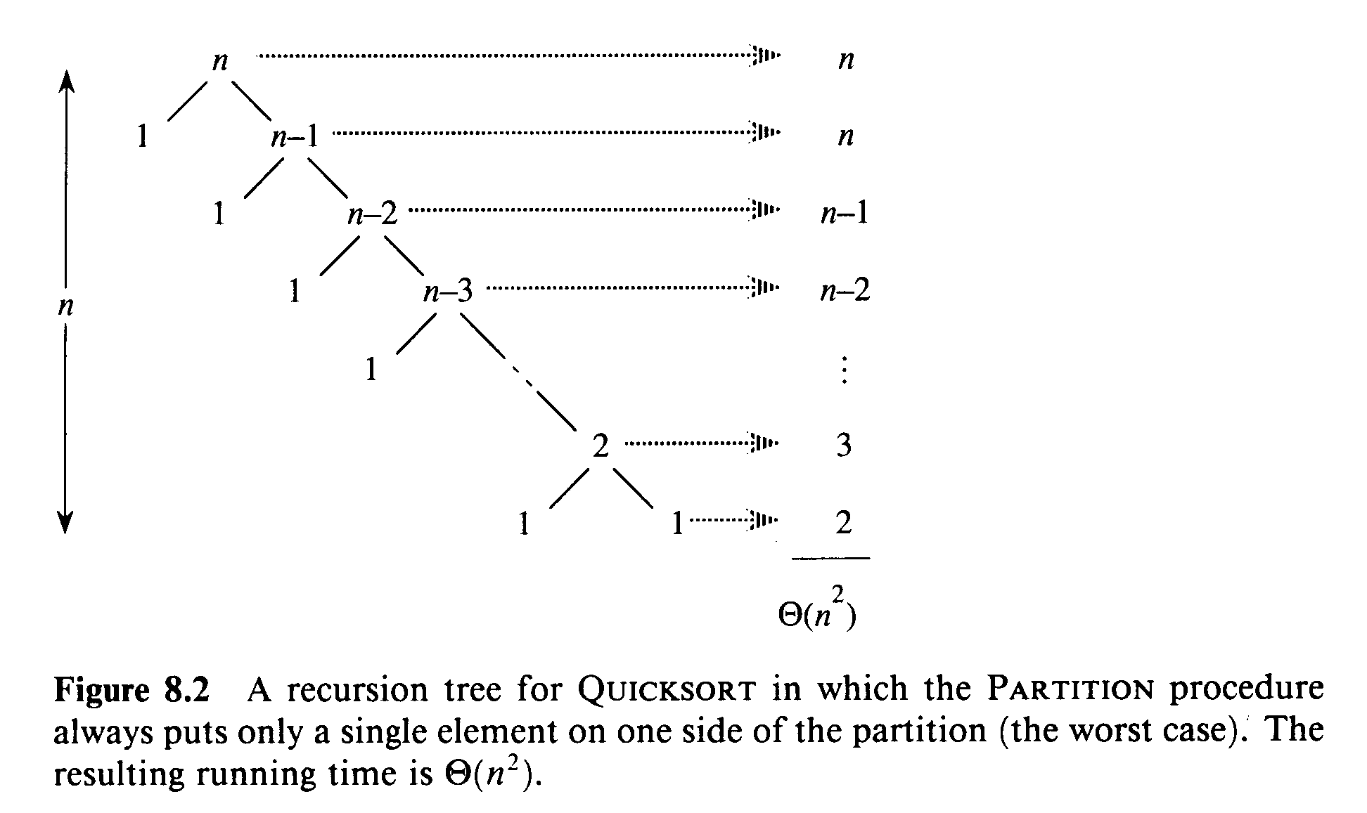
Worst Case Partitioning

Slide 32
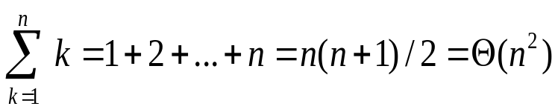
Worst Case Partitioning
Worst-Case Performance (unbalanced):
  T(n) = T(0) + T(n-1) + Θ(n)
    partitioning takes Θ(n)
  = Θ(n²)
This occurs when
  the input is completely sorted
or when
  the pivot is always the smallest (largest) element

Slide 33
Best-case analysis
(For intuition only!)
If we’re lucky, PARTITION splits the array evenly:
T(n) = 2T(n/2) + Θ(n)
= Θ(n lg n)
(same as merge sort)

Slide 34
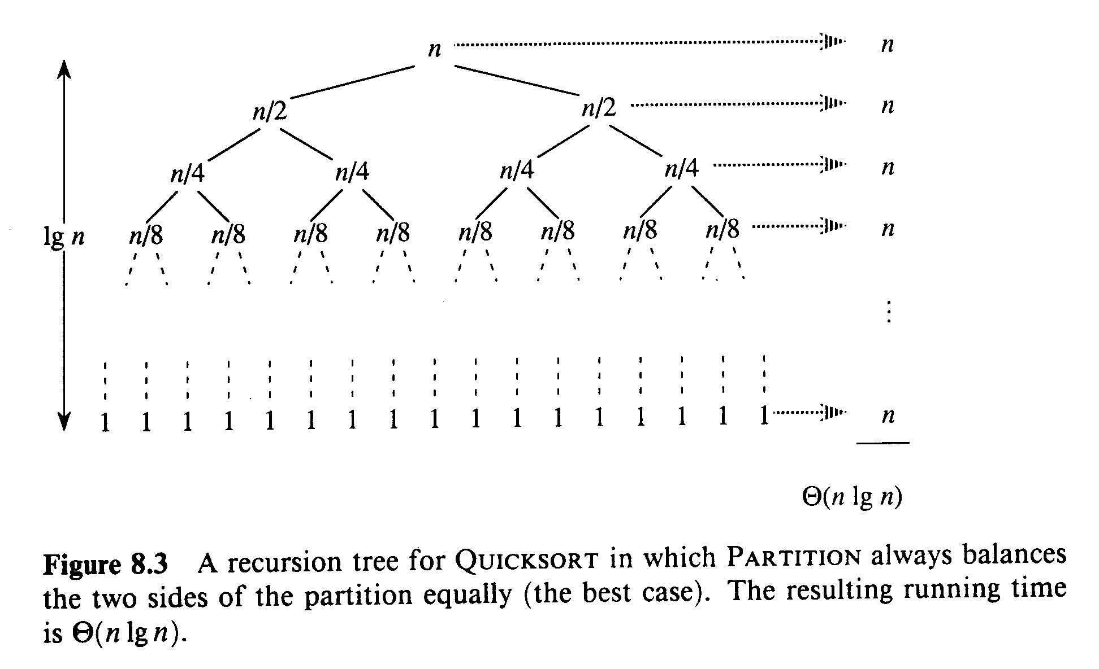
Best Case Partitioning

Slide 35
Best-case analysis
(For intuition only!)
If we’re lucky, PARTITION splits the array evenly:
T(n) = 2T(n/2) + Θ(n)
= Θ(n lg n)
(same as merge sort)
What if the split is always ¹ : ⁹ ?
10 10
T (n) = T ( n)+ T ( n)+ Θ(n)
1 9
10 10
What is the solution to this recurrence?

Slide 36
Analysis of “almost-best” case
T (n)

Slide 37
Analysis of “almost-best” case
cn
T ( n)
T ( n)
1
9
10
10

Slide 38
Analysis of “almost-best” case
cn
1 _{cn}
9 _{cn}
10
10
T ( n)T ( n)
T (
n)T ( n)
1
9
9
81
100
100
100
100

Slide 39



Analysis of “almost-best” case
cn
cn
cn
1 _{cn}
9 _{cn}
10
10
log n
9 _{cn}
81 _{cn}
10/9
¹ cn ⁹ cn
100 100
cn
100
100
Θ(1)
O(n) leaves
Θ(1)

Slide 40

Analysis of “almost-best” case
cn
cn
cn
1 _{cn}
9 _{cn}
log
10
10
log n
10
10/9
^{n 1} cn ⁹ cn
100 100
9 _{cn}
81 _{cn}
cn
100
100
Θ(1)
Θ(n lg n)
Lucky!
O(n) leaves
Θ(1)
cn log₁₀n ≤ T(n) ≤ cn log_{10/9}n + Ο(n)

Slide 41
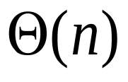
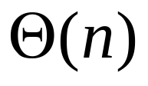

Average Case
What happens if we bad-split root node, then good-split the resulting size (n-1) node?
  We end up with three subarrays, size
    0, ((n-1)/2)-1, (n-1)/2
  Combined cost of splits = Θ(n) + Θ(n-1) = Θ(n)
n
n
0
n-1
((n-1)/2)-1
(n-1)/2
(n-1)/2
(n-1)/2

Slide 42
More intuition
Suppose we alternate lucky, unlucky, lucky, unlucky, lucky, ….
L(n) = 2U(n/2) + Θ(n)
U(n) = L(n – 1) + Θ(n)
lucky unlucky
Solving:
L(n) = 2(L(n/2 – 1) + Θ(n/2)) + Θ(n)
= 2L(n/2 – 1) + Θ(n)
= Θ(n lg n)
Lucky!
How can we make sure we are usually lucky?
The combination of good and bad splits would result in T(n) = O (n lg n), but with slightly larger constant hidden by the O-notation

Slide 43
in-place algorithm
An in-place algorithm is an algorithm which transforms input using no auxiliary data structure.
However a small amount of extra storage space is allowed for auxiliary variables.
The input is usually overwritten by the output as the algorithm executes.
In-place algorithm updates input sequence only through replacement or swapping of elements.
An algorithm which is not in-place is sometimes called not-in-place or out-of-place

Slide 44
Quicksort
Quicksort pros [advantage]:
  Sorts in place
  Sorts O(n lg n) in the average case
  Very efficient in practice , it’s quick
Quicksort cons [disadvantage]:
  Sorts O(n²) in the worst case
  And the worst case doesn’t happen often … sorted
Notes:
an in-place algorithm is an algorithm which transforms input using no auxiliary data structure. However a small amount of extra storage space is allowed for auxiliary variables. The input is usually overwritten by the output as the algorithm executes. In-place algorithm updates input sequence only through replacement or swapping of elements. An algorithm which is not in-place is sometimes called not-in-place or out-of-place

Slide 45
Randomized Quicksort
An algorithm is randomized if its behavior is determined not only by the input but also by values produced by a random-number generator.
Exchange A[r] with an element chosen at random from A[p…r] in Partition.
This ensures that the pivot element is equally likely to be any of input elements.
We can sometimes add randomization to an algorithm in order to obtain good average-case performance over all inputs.

Slide 46
Randomized Quicksort
Randomized-Partition(A, p, r)
1. i ← Random(p, r)
2. exchange A[r] ↔ A[i]
3. return Partition(A, p, r)
Randomized-Quicksort(A, p, r)
1. if p < r
2. then q ← Randomized-Partition(A, p, r)
3. Randomized-Quicksort(A, p , q-1)
4. Randomized-Quicksort(A, q+1, r)
swap
pivot

Slide 47
Review: Analyzing Quicksort
What will be the worst case for the algorithm?
  Partition is always unbalanced
What will be the best case for the algorithm?
  Partition is balanced

Slide 48
Summary: Quicksort
In worst-case, efficiency is Θ(n²)
  But easy to avoid the worst-case
On average, efficiency is Θ(n lg n)
Better space-complexity than mergesort.
In practice, runs fast and widely used

Slide 49
Practice Excercise
Select value at last index as pivot value and draw complete recurrence tree for quick sort. Describe its efficiency in terms of relating it with Best/worst/average case
10,15,4,7,32,65,2,45,20
10,20,30,40,50,60,70,80,90
56,45,35,32,29,18,11,10,7,8
10,10,10,10,10,10,10,10,10,10

Slide 50
Practice Excercise
Select value at middle index of an array as pivot value and draw complete recurrence tree for quick sort. Describe its efficiency in terms of relating it with Best/worst/average case
10,15,4,7,32,65,2,45,20
10,20,30,40,50,60,70,80,90
56,45,35,32,29,18,11,10,7,8
10,10,10,10,10,10,10,10,10,10

Slide 51
Practice Excercise
Select value at first index as pivot value and draw complete recurrence tree for quick sort. Describe its efficiency in terms of relating it with Best/worst/average case
10,15,4,7,32,65,2,45,20
10,20,30,40,50,60,70,80,90
56,45,35,32,29,18,11,10,7,8
10,10,10,10,10,10,10,10,10,10

Slide 52
Practice Excercise
Select pivot value using randomized quick_sort and draw complete recurrence tree for quick sort. Describe its efficiency in terms of relating it with Best/worst/average case
10,15,4,7,32,65,2,45,20
10,20,30,40,50,60,70,80,90
56,45,35,32,29,18,11,10,7,8
10,10,10,10,10,10,10,10,10,10

Slide 53
Reference
Introduction to Algorithms
  Chapter # 7
  Thomas H. Cormen
  3rd Edition

